Slide 1

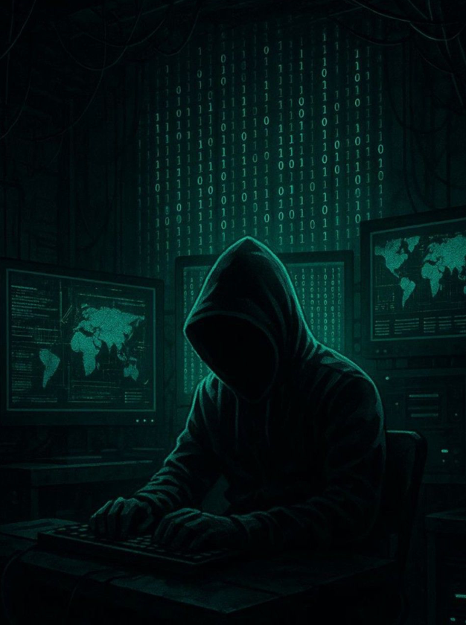

HACK MATRIX HACKATHON
TITLE PAGE
PROJECT TITLE : Drishti : Intelligent Screen Time & Eye Care App
TEAM NAME : Team Hackoholics
TEAM MEMBERS : Ayush Tiwari, Chandashi Gupta, Shivi Sanjay, Aroosh Datta

Slide 2
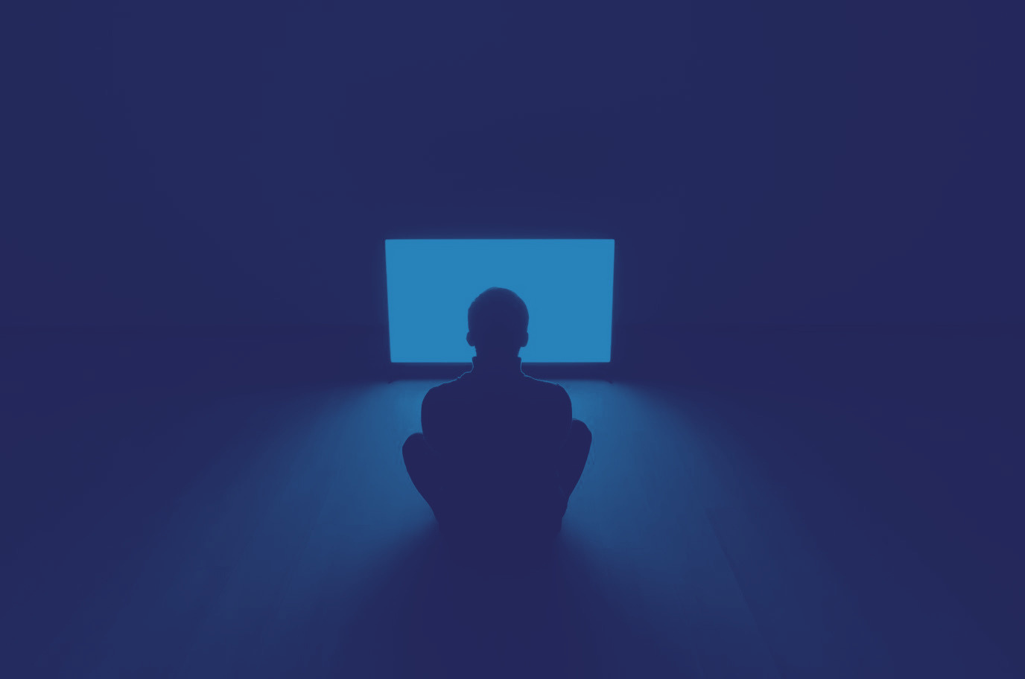
PROBLEM STATEMENT
Describe the problem clearly: Excessive time spent on screens causes digital eye strain, which results in dry eyes, headaches, and blurred vision. People ignore these problems until they get worse.
Who is affected by this problem: Professional surveys report that 70% of screen users experience DES symptoms (dry/irritated eyes, headaches, blurred vision)
Why this problem is important: Under prolonged focus the blink rate plummets from ~15–20 blinks/minute to 5–7 blinks/minute, causing tear-film evaporation and irritation. In practice, even simple advice like the 20‑20‑20 rule (look 20ft away every 20 min) is neglected under tight deadlines

Slide 3

EXISTING SOLUTIONS AND GAPS
List of existing Solutions : Current solutions include native device focus modes, Pomodoro-based productivity timers, and basic applications that remind users to follow the 20-20-20 rule. These tools aim to reduce screen fatigue by encouraging periodic breaks.
Mention their Limitations : Most existing solutions rely on fixed time intervals and do not adapt to the user’s actual condition or level of fatigue. They lack personalization and fail to consider physiological indicators such as blink rate or viewing distance. Additionally, these tools are often passive and easy to ignore, reducing their effectiveness over time.
Explain the gap your project will address : There is a clear gap between passive reminder systems and intelligent health monitoring. Our approach focuses on bridging this gap by incorporating real-time tracking of user behavior and physiological indicators, combined with interactive and guided eye exercises. This ensures a more engaging, adaptive, and effective solution for preventing digital eye strain.

Slide 4
PROPOSED SOLUTION : Drishti
Explain your solution clearly: Drishti is an intelligent web-based application designed to monitor screen usage and detect early signs of eye fatigue in real time. Unlike traditional reminder systems, it uses webcam-based tracking and behavioral analysis to understand user strain levels and proactively guide users to follow the 20-20-20 rule through interactive and engaging interventions.
List key features: Drishti features real-time webcam tracking of blink rate and screen distance to detect eye strain. It provides smart 20-20-20 rule reminders and guided eye exercise animations. The app also includes daily screen-time graphs and personalized weekly eye health tips. All features adapt to user behavior for timely and effective intervention.
Explain how it solves the problem: By intervening at precise times based on eye strain signs and guiding the user through an exercise, it ends the cycle of constant visual strain before the signs and symptoms appear.

Slide 5
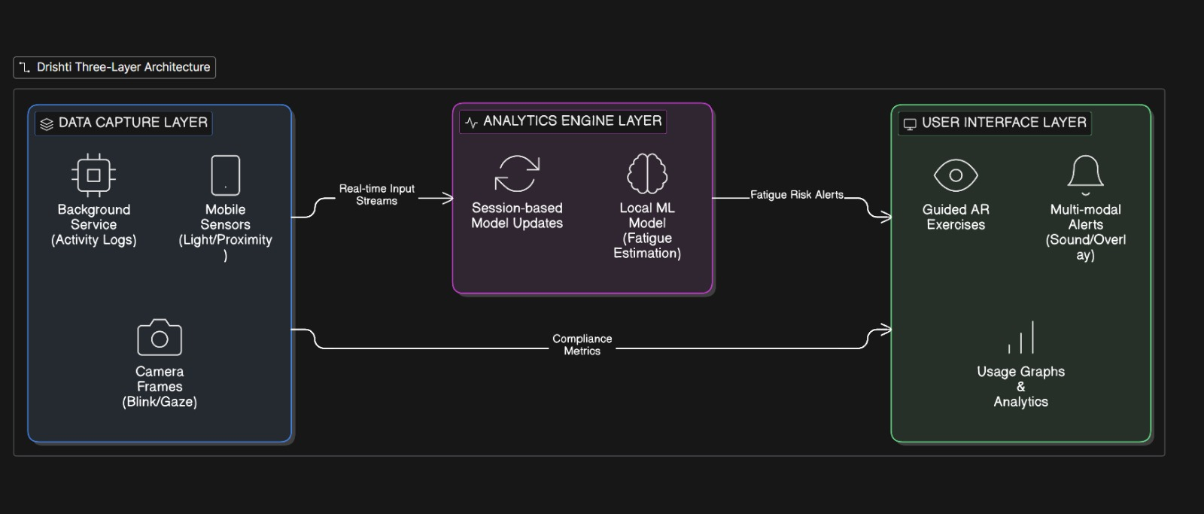
SYSTEM ARCHITECTURE

Slide 6
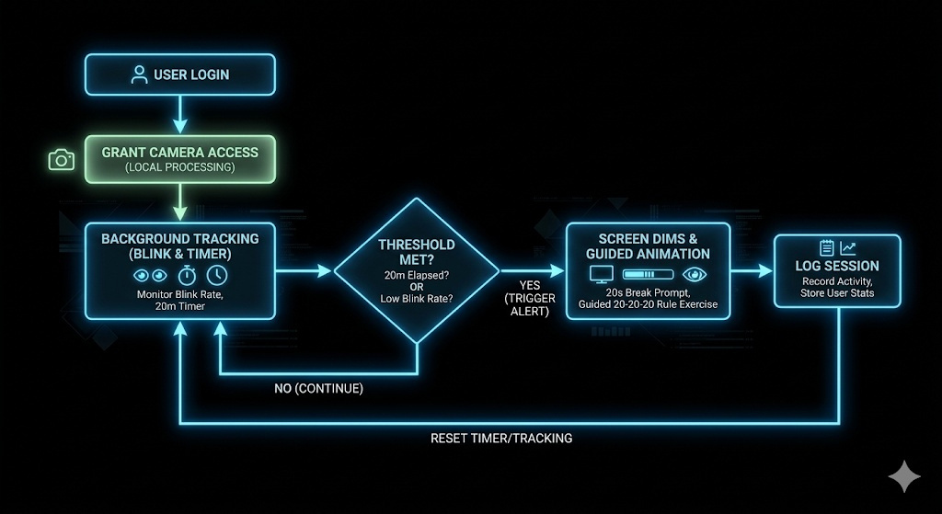
FLOWCHART / WORKING PROCESS

Slide 7
TECH STACK
Frontend technologies: React.js (Component-based architecture allows for smooth UI updates without reloading the page during background tracking).
Backend technologies: Python with FastAPI or Flask (Lightweight, incredibly fast, and excellent if you decide to move any data analysis to the server later).
Database: MongoDB (Flexible document schema is perfect for logging daily, unstructured time-series data).
Tools and APIs used:
1. MediaPipe Face Mesh: For highly efficient, client-side blink and distance detection.
2. Canva: To design custom UI elements and guided eye-exercise animations.
3. Chart.js / Recharts: To render interactive daily screen-time graphs.

Slide 8
IMPLEMENTATION PLAN
Step-by-step development plan: 1. Design UI and animations.
2. Build React frontend with the 20-20-20 timer.
3. Integrate MediaPipe for advanced tracking.
4. Connect Python backend for user data logging.
Modules or features to be built: Authentication module, Timer/Alert module, Computer Vision Tracking module, and the Analytics Dashboard.

Slide 9
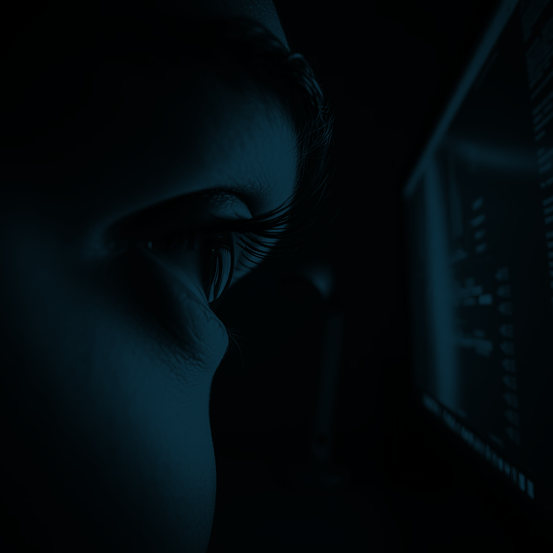
EXPECTED OUTCOME / IMPACT
Expected results of the project: A fully functional web app delivering timer-based alerts, eye exercise animations, daily graphs, and weekly tips.
Benefits to users: Drastic reduction in digital eye strain, better posture awareness, and improved long-term eye health.
Real-world impact: Promotes digital wellness and healthier workplace ergonomics in an increasingly screen-dependent world.

Slide 10
FUTURE SCOPE AND CONCLUSION
Future improvements : Developing a native desktop app wrapper (Electron) to control screen brightness directly, and integrating blue-light filtering schedules.
Final summary: Can be scaled into corporate wellness programs where companies offer the tool to employees to track overall team ergonomic health.
Scalability of the project: Drishti transforms passive eye-care guidelines into an active, intelligent, and engaging digital health companion.

